Slide 1


SSH Log Data Governance: Comprehensive Implementation
A Three-Phase Approach to Secure Data Management
This presentation outlines a robust governance framework for SSH log data focusing on data analysis, cleaning, and privacy implementations. Our approach secures sensitive access information while maintaining compliance with regulatory standards. Learn how this foundation supports advanced security monitoring and sustainable data governance across enterprise security datasets.
by Omar hazem ahmed

Slide 2

Introduction to SSH Log Data
Data Sensitivity
Governance Challenges
SSH logs include credentials like usernames, passwords, timestamps, and geographic data, making them highly sensitive and critical for security monitoring.
Maintaining data quality and enforcing security controls while complying with privacy regulations requires rigorous governance measures.
Security Importance
Effective governance enables detection of unauthorized access and supports incident response without compromising user privacy.

Slide 3
Data Analysis Methodology
Statistical Profiling
Temporal & Geographic Analysis
Data Quality Assessment
Comprehensive profiling to identify distributions, anomalies, and patterns across all data fields including timestamps and IP addresses.
Identifying missing data, duplicates, and format inconsistencies to inform cleaning processes and validation metrics.
Detecting attack windows and global risk hotspots through time-series and geolocation data mapping.

Slide 4
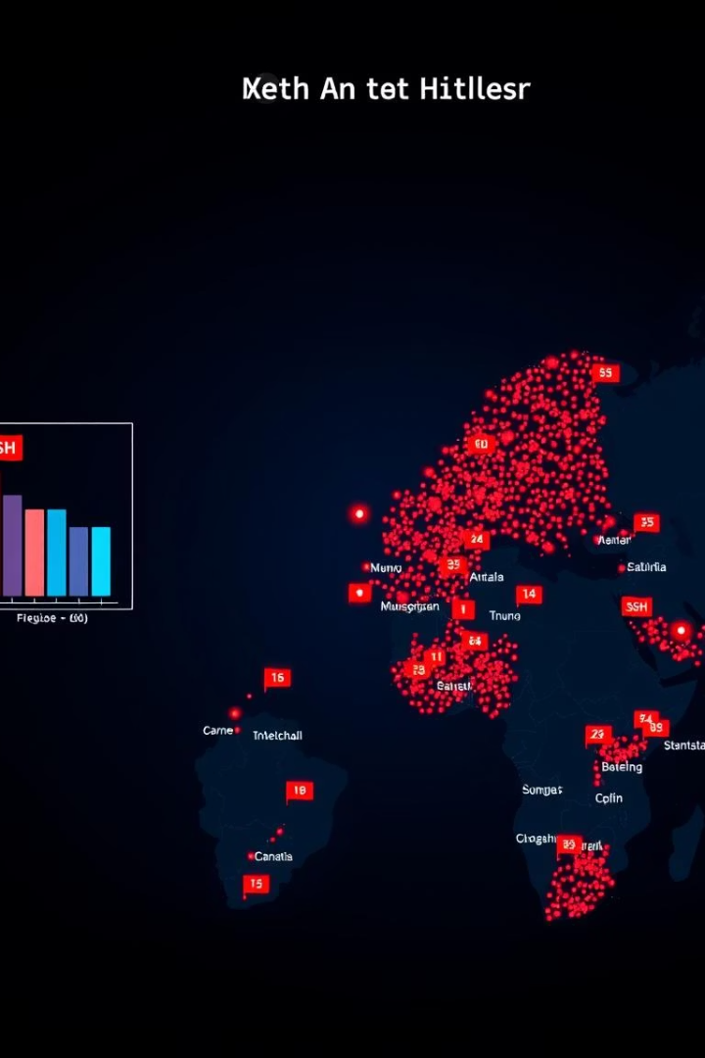
Key Analysis Findings
Login Records
Peak Activity
Dataset includes 84,379 login attempts with 8 columns, predominantly from Australia, the U.S., and Singapore.
Highest login attempt spikes during early morning hours (4-6 AM), peaking at 9,449 attempts at 6 AM.
Data Issues
Detected 5 null username entries and 147 null password values, plus 1,423 unique IP addresses with suspicious repeated attempts.

Slide 5





Data Cleaning Process
Duplicate Removal
Ensuring data integrity by identifying and deleting redundant records.
Imputation Techniques
Applying median for numeric and mode for categorical fields to fill missing values appropriately.
Outlier Detection
Using Interquartile Range (IQR) to spot and handle anomalous data points affecting reliability.
Schema Validation
Employing Pandera for strict data type enforcement and documenting the expected dataset structure.

Slide 6
Security Implementation & Access Control
Encryption Strategies
Role-Based Access Control
Fernet symmetric encryption secures passwords; Caesar cipher applied to usernames and locations; IPs anonymized by zeroing last octet.
Defined 10 roles including admin, security, analyst, and auditor with least privilege assignment and mandatory interaction logging.

Slide 7

Regulatory Compliance & Validation Results
Achieved GDPR, CCPA, and HIPAA compliance through data minimization, pseudonymization, audit controls, and automated compliance checks. Documented each framework to support audits.
Data cleaning validated results: 98.9% retention rate with 83,487 clean records free of duplicates, consistent formatting, and handled anomalies, ensuring trustworthy datasets for analysis.

Slide 8




Conclusion & Recommendations
Automated Governance Pipeline
Secure Key Management
1
Continuously monitor, clean, and secure SSH log data for reliability and compliance.
2
Improve encryption key protection for long-term data recoverability.
Integration & Monitoring
4
Quarterly Compliance Audits
Enhance threat detection by combining SSH log analysis with existing security systems.
3
Ensure sustained adherence to evolving regulations.
By establishing advanced governance frameworks, organizations can unlock security insights while maintaining strict data protection and regulatory alignment, driving business value and continuous improvement.

